Slide 1
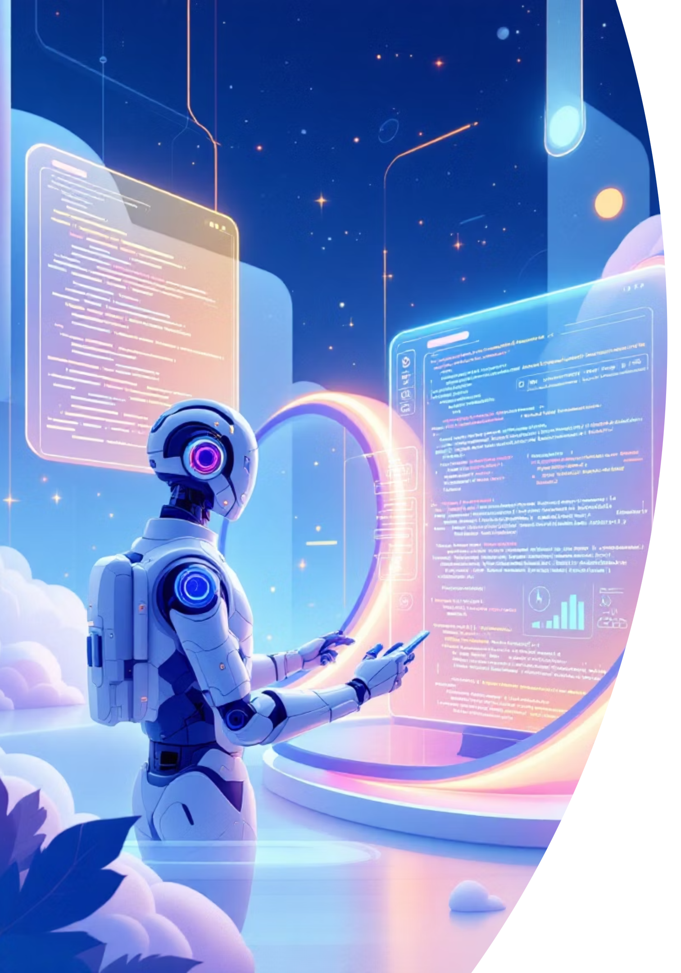
Transform Your Testing Career: Journey to Gen AI Testing
A comprehensive workshop for software testers ready to embrace the future of testing with Generative AI and Agentic AI technologies.

Slide 2






Understanding the AI Landscape
Let's break down the three key technologies that are reshaping software testing today.
Traditional AI
Generative AI
Agentic AI
Follows rules you set
Creates new content
Takes action independently
Example: A calculator that adds numbers, a spam filter that sorts emails, or a chatbot with pre-written responses
Example: ChatGPT writing emails, DALL-E creating images, or AI generating test scenarios from requirements
Example: AI that books your entire trip, manages your calendar, or runs complete test suites autonomously

Slide 3


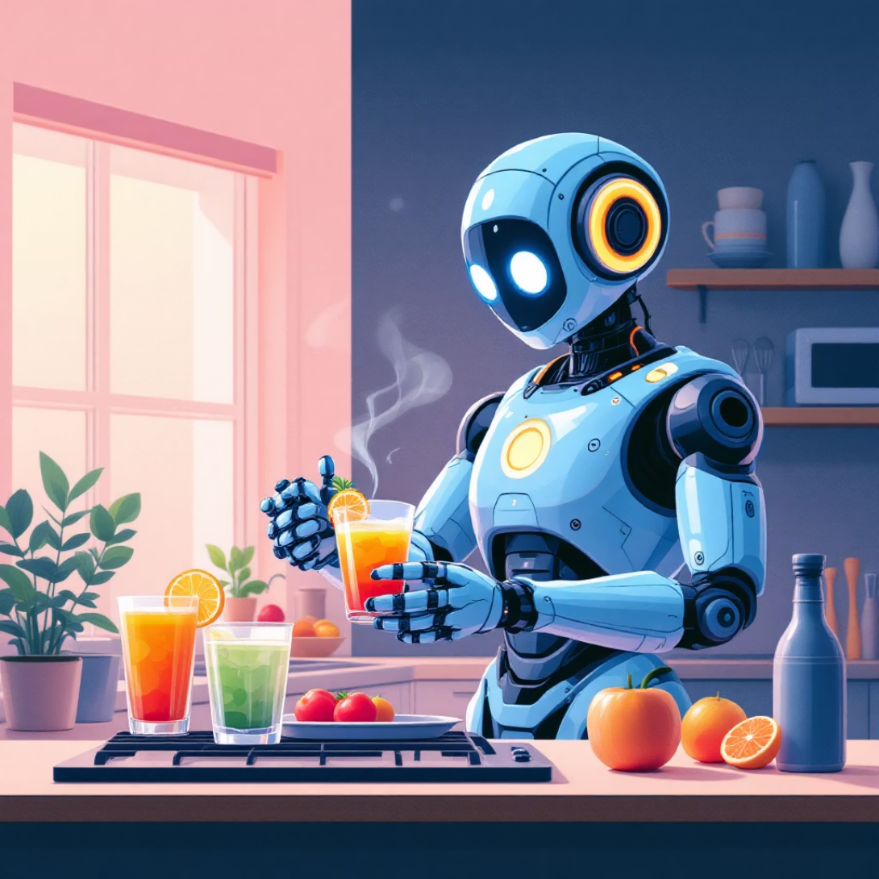
Real-World Analogy: Making Tea
Traditional AI
Generative AI
Agentic AI
You tell it: "Boil water, add tea leaves, pour in cup." It follows exact steps every time.
You say: "Make me a refreshing drink." It creates a new recipe: iced tea with mint and lemon.
You mention: "I'm tired." It decides you need tea, orders supplies, and prepares it for you.

Slide 4

The Mindset Shift: Traditional vs Gen AI Testing
Traditional Testing Mindset
Follow detailed test cases step-by-step
Manually check every feature
Document bugs in spreadsheets
Repeat same tests for every release
Gen AI Testing Mindset
Teach AI to understand requirements
Let AI generate test scenarios
Guide AI agents to find bugs automatically
Focus on strategy while AI handles execution

Slide 5
Prerequisites for Gen AI Testing Success
Build your foundation with these essential skills to thrive in the AI testing landscape.
01
02
Testing Fundamentals
Curious Mindset
Strong grasp of testing principles, bug lifecycle, and quality assurance practices
Willingness to experiment, learn from failures, and explore new AI tools
03
04
Basic Technical Skills
Problem-Solving Ability
Comfort with APIs, understanding of JSON, and ability to read simple code
Think creatively about how AI can solve testing challenges

Slide 6





5 Core Components to Master Gen AI Testing
Prompt Engineering
Learn to communicate with AI effectively. Write clear instructions that get accurate results from AI models.
Core Python
Understand Python basics to automate tests, process data, and integrate AI tools into your workflow.
APIs & Integration
Connect different systems, send requests to AI models, and retrieve testing data programmatically.
LangChain Framework
Build AI applications that chain multiple AI actions together for complex testing scenarios.
CrewAI Framework
Create teams of AI agents that work together autonomously to complete testing tasks end-to-end.

Slide 7


Capstone Project: AI Trip Planner Application
What We'll Build
An intelligent trip planning application where users simply describe their dream vacation, and AI agents automatically:
Research destinations
Find best flight options
Recommend hotels
Testing Focus
Create day-by-day itinerary
You'll learn to test:
Calculate complete budget
How prompts are interpreted
Accuracy of AI responses
Agent coordination
Error handling scenarios
Output quality validation

Slide 8





How Your Prompt Becomes Action
User Prompt: "Plan a 5-day beach vacation for my family in Goa under ₹50,000"
Prompt Analysis
Task Planning
LLM breaks down: destination (Goa), duration (5 days), type (beach), audience (family), budget (₹50K)
LLM creates task list: search flights, find hotels, research activities, calculate costs
Tool Activation
Result Assembly
LLM activates specific tools: flight API, hotel search, weather API, cost calculator
LLM combines all outputs into complete itinerary with day-wise plan and budget breakdown

Slide 9





AI Agents in Action: Trip Planner Architecture
Travel Agent
Searches flights, compares prices, checks availability, and recommends best options based on budget and preferences.
Hotel Agent
Finds hotels near beaches, filters by family-friendly amenities, checks reviews, and ensures budget compliance.
Itinerary Agent
Creates day-by-day schedule, balances activities and rest, suggests local attractions, and plans meal times.
Budget Agent
Tracks all expenses, ensures total stays within limit, suggests cost-saving alternatives, and provides detailed breakdown.
Each agent works independently but shares information to create a seamless, coordinated plan.

Slide 10


Your Journey Starts Now
Next Steps to Transform Your Career
1
Master the Fundamentals
2
Practice with Real Projects
Start with prompt engineering and basic Python—these are your foundation.
Build the AI Trip Planner and similar applications to gain hands-on experience.
3
Join the AI Testing Community
Connect with other testers, share learnings, and stay updated with latest tools.
Remember: The future of testing is not about replacing testers—it's about empowering testers with AI superpowers. Start your transformation today!

